Slide 1

CROWD COUNTING APP
HUMAN
CLASSIFICATION
1

Slide 2
Aim of the Lecture
The lectures objectives is to introduce you to human crowd counting with gender classification.
2
Notes:
Image source: https://cs231n.github.io/classification

Slide 3
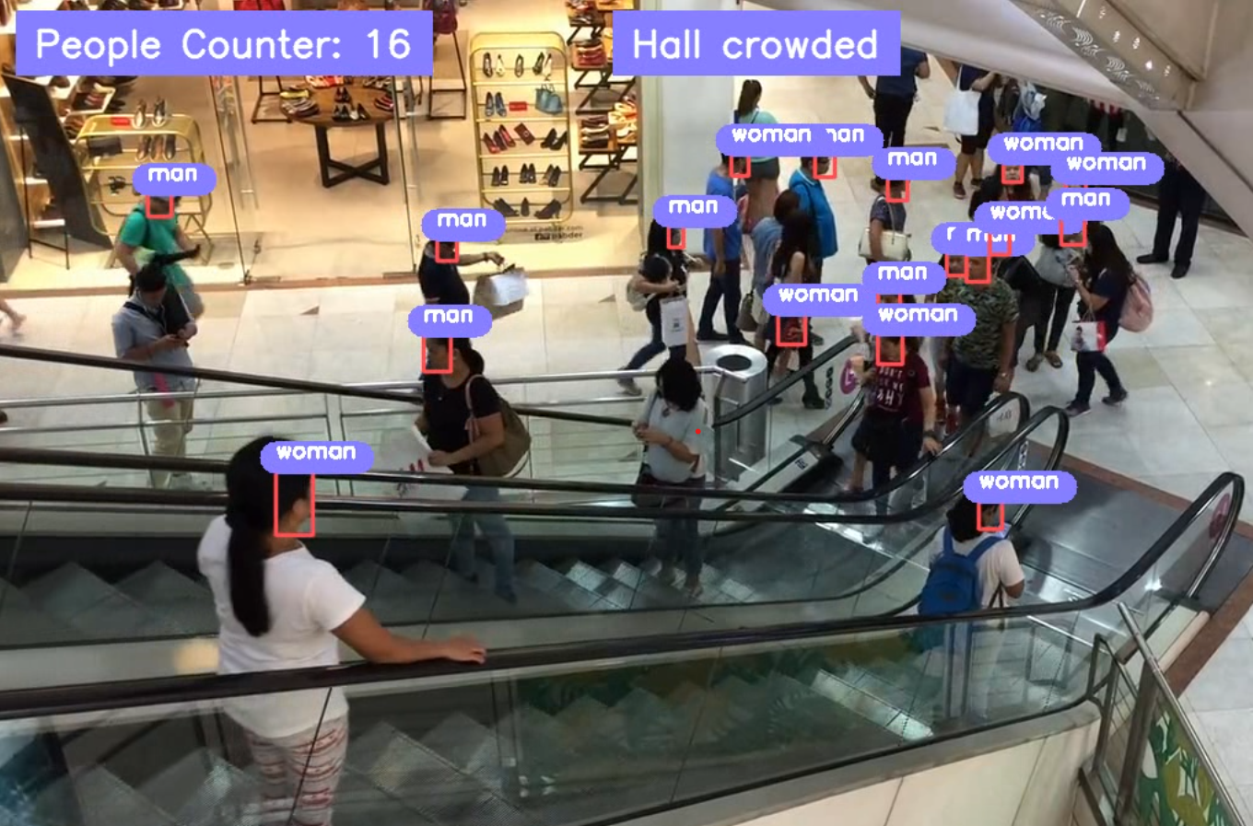
Introduction
Crowd counting refers to estimating the number of individuals who share a certain region. This methods calculates how many individuals are in a physical region using deep learning.
3

Slide 4
Methods of counting crowds
Due to the rapid progress in technology and growth of CNN (Convolutional Neural Network) over the last decade, the usage of CNN in crowd counting has skyrocketed. The CNN based methods can largely be grouped under the following different models.
4

Slide 5
Jacobs' method
Jacobs' method involves dividing the area occupied by a crowd into sections, determining an average number of people in each section, and multiplying by the number of sections occupied.
5

Slide 6
Direct regression-based counting
This crowd counting method involves using regression on global image features to the whole image. Global image features refer to the different properties of certain areas of the photo.
6

Slide 7
Density-based counting
Object density maps rely on finding the total number of objects located in a particular area. This is determined by the integral summation of the number of objects in that area.
Due to the density values being estimated through low values, density-based counting allows the user to experience advantages of regression-based models alongside localisation of information.
7

Slide 8
Importance
Crowd counting plays an important role in “public safety, assembly language, and video surveillance” amongst many things. Without crowd control, through poor planning, several terrible accidents can occur.
8

Slide 9
THANK YOU!
Web: www.augmentedstartups.com
WhatsApp: www.augmentedstartups.info/whatsapp

